Slide 1
TRANSACTION PROCESSING
AND
CONCURRENCY CONTROL
Chapter – 7

Slide 2
Outline
Introduction to Transaction Processing
Transaction and System Concepts
Desirable Properties of Transactions
Characterizing Schedules based on Recoverability
Characterizing Schedules based on Serializability
Databases Concurrency Control
  Purpose of Concurrency Control
  Two-Phase locking
  Limitations of CCMs

Slide 3
Introduction to Transaction Processing
Single-User System
  At most one user at a time can use the system
Multiuser System
  Many users can access the system concurrently
Concurrency
  Interleaved processing
    Concurrent execution of processes is interleaved in a single CPU
  Parallel processing
    Processes are concurrently executed in multiple CPUs

Slide 4
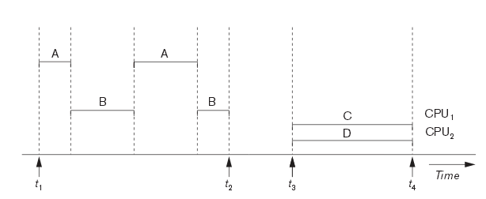
Interleaved processing versus Parallel processing of Concurrent Transactions

Slide 5
Introduction to Transaction Processing
A Transaction
  Logical unit of database processing that includes one or more access operations (read -retrieval, write - insert or update, delete)
A transaction (set of operations) may be stand-alone specified in a high level language like SQL submitted interactively, or may be embedded within a program.
Transaction boundaries
  Begin and End transaction
An application program may contain several transactions separated by the Begin and End transaction boundaries

Slide 6
Introduction to Transaction Processing
A transaction is a unit of program execution that accesses and possibly updates various data items.
E.g., transaction to transfer $50 from account A to account B:
  1. read(A)
  2. A := A – 50
  3. write(A)
  4. read(B)
  5. B := B + 50
  6. write(B)
Two main issues to deal with:
  Failures of various kinds, such as hardware failures and system crashes
  Concurrent execution of multiple transactions

Slide 7
Introduction to Transaction Processing
SIMPLE MODEL OF A DATABASE
A database is a collection of named data items
Granularity of data - a field, a record , or a whole disk block
Basic operations are read and write
  read_item(X): Reads a database item named X into a program variable.
  write_item(X): Writes the value of program variable X into the database item named X

Slide 8
Introduction to Transaction Processing
READ AND WRITE OPERATIONS
Basic unit of data transfer from the disk to the computer main memory is one block
In general, a data item (what is read or written) will be the field of some record in the database, although it may be a larger unit such as a record or even a whole block
read_item(X) command includes the following steps
  1. Find the address of the disk block that contains item X.
  2. Copy that disk block into a buffer in main memory (if that disk block is not already in some main memory buffer)
  3. Copy item X from the buffer to the program variable named X

Slide 9
Introduction to Transaction Processing
write_item(X) command includes the following steps
  1. Find the address of the disk block that contains item X
  2. Copy that disk block into a buffer in main memory (if that disk block is not already in some main memory buffer)
  3. Copy item X from the program variable named X into its correct location in the buffer
  4. Store the updated block from the buffer back to disk (either immediately or at some later point in time)

Slide 10

Two sample transactions
Two sample transactions
  (a) Transaction T1
  (b) Transaction T2

Slide 11
Why Concurrency Control is needed?
The Lost Update Problem
  This occurs when two transactions that access the same database items have their operations interleaved in a way that makes the value of some database item incorrect
The Temporary Update (or Dirty Read) Problem
  This occurs when one transaction updates a database item and then the transaction fails for some reason
  The updated item is accessed by another transaction before it is changed back to its original value
The Incorrect Summary Problem
  If one transaction is calculating an aggregate summary function on a number of records while other transactions are updating some of these records, the aggregate function may calculate some values before they are updated and others after they are updated

Slide 12
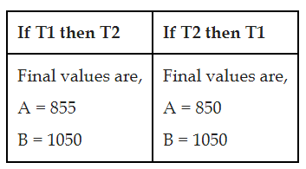
Example
Let us assume that the initial value of data items A and B are 1000 and 1000 respectively. Transaction T1 transfers 50 from A to B. Transaction T2 withdraws 10% of amount from A. If T1 and T2 are executed in serial order then the final values will be as given in the Table 1;
Let us suppose that we go for concurrent execution of T1 and T2, ie., the instructions of both transactions are interleaved.

Slide 13
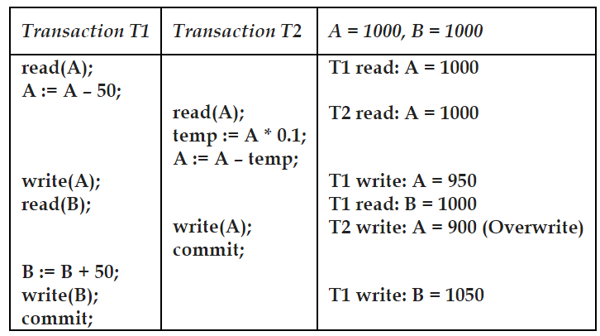
Lost Update Problem - Example

Slide 14
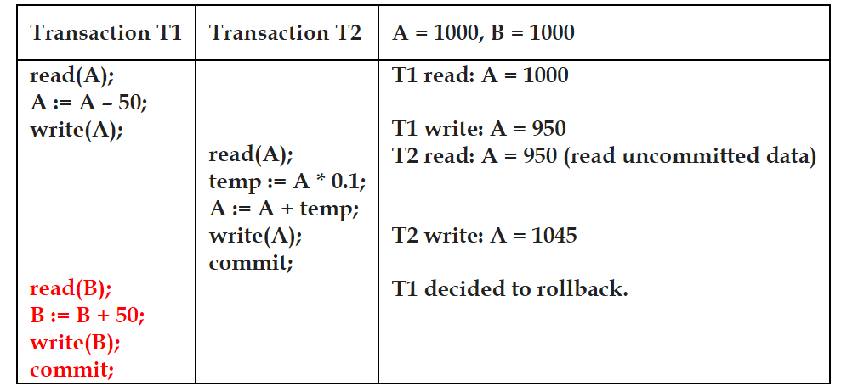
The temporary update problem / Dirty Read Problem - Example

Slide 15
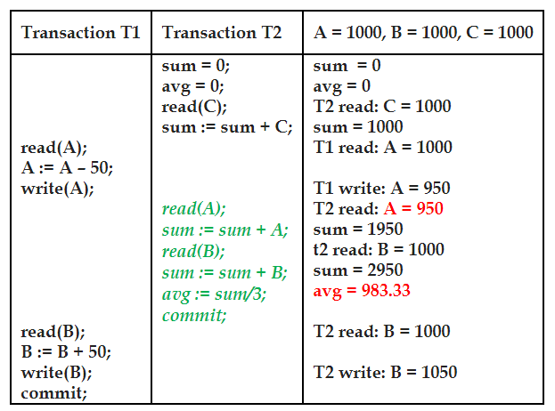
The incorrect Summary problem - Example

Slide 16
Why recovery is needed?
What causes a Transaction to fail?
1. A computer failure (system crash): A hardware or software error occurs in the computer system during transaction execution. If the hardware crashes, the contents of the computer’s internal memory may be lost
2. A transaction or system error : Some operation in the transaction may cause it to fail, such as integer overflow or division by zero. Transaction failure may also occur because of erroneous parameter values or because of a logical programming error. In addition, the user may interrupt the transaction during its execution

Slide 17
Why recovery is needed?
3. Local errors or exception conditions detected by the transaction:
Certain conditions necessitate cancellation of the transaction.
For example, data for the transaction may not be found. A condition, such as insufficient account balance in a banking database, may cause a transaction, such as a fund withdrawal from that account, to be canceled
4. Concurrency control enforcement: The concurrency control method may decide to abort the transaction, to be restarted later, because it violates serializability or because several transactions are in a state of deadlock

Slide 18
Why recovery is needed?
5. Disk failure: Some disk blocks may lose their data because of a read or write malfunction or because of a disk read/write head crash. This may happen during a read or a write operation of the transaction.
6. Physical problems and catastrophes: This refers to an endless list of problems that includes power or air-conditioning failure, fire, theft, sabotage, overwriting disks or tapes by mistake, and mounting of a wrong tape by the operator.

Slide 19
Transaction and System Concepts
A transaction is an atomic unit of work that is either completed in its entirety or not done at all.
For recovery purposes, the system needs to keep track of when the transaction starts, terminates, and commits or aborts.
Transaction states
  Active state
  Partially committed state
  Committed state
  Failed state
  Terminated State

Slide 20
Transaction and System Concepts
Recovery manager keeps track of the following operations:
begin_transaction: This marks the beginning of transaction execution.
read or write: These specify read or write operations on the database items that are executed as part of a transaction.
end_transaction: This specifies that read and write transaction operations have ended and marks the end limit of transaction execution.
  At this point it may be necessary to check whether the changes introduced by the transaction can be permanently applied to the database or whether the transaction has to be aborted because it violates concurrency control or for some other reason

Slide 21
Transaction and System Concepts
commit_transaction: This signals a successful end of the transaction so that any changes (updates) executed by the transaction can be safely committed to the database and will not be undone
rollback (or abort): This signals that the transaction has ended unsuccessfully, so that any changes or effects that the transaction may have applied to the database must be undone
undo: Similar to rollback except that it applies to a single operation rather than to a whole transaction
redo: This specifies that certain transaction operations must be redone to ensure that all the operations of a committed transaction have been applied successfully to the database

Slide 22
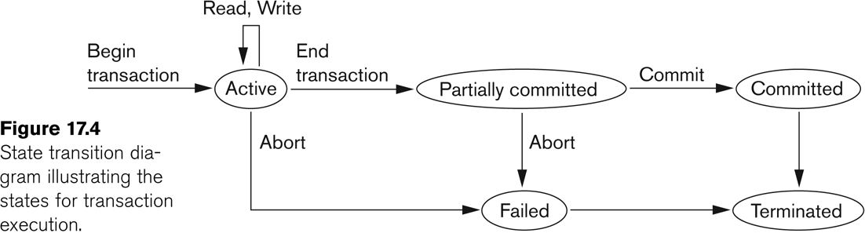
State transition diagram illustrating the states for transaction execution

Slide 23
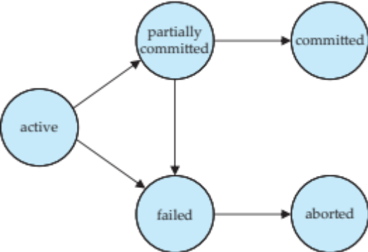
Transaction States
Active – the initial state; the transaction stays in this state while it is executing
Partially committed – after the final statement has been executed.
Failed -- after the discovery that normal execution can no longer proceed.
Aborted – after the transaction has been rolled back and the database restored to its state prior to the start of the transaction. Two options after it has been aborted:
  Restart the transaction
    Can be done only if no internal logical error
  Kill the transaction
Committed – after successful completion.

Slide 24
Transaction and System Concepts
The System Log
  Log or Journal: The log keeps track of all transaction operations that affect the values of database items
    This information may be needed to permit recovery from transaction failures.
    The log is kept on disk, so it is not affected by any type of failure except for disk or catastrophic failure.
    In addition, the log is periodically backed up to archival storage (tape) to guard against such catastrophic failures

Slide 25
Transaction and System Concepts
Types of log record
[start_transaction,T]: Records that transaction T has started execution
[write_item,T,X,old_value,new_value]: Records that transaction T has changed the value of database item X from old_value to new_value
[read_item,T,X]: Records that transaction T has read the value of database item X
[commit,T]: Records that transaction T has completed successfully, and affirms that its effect can be committed (recorded permanently) to the database
[abort,T]: Records that transaction T has been aborted

Slide 26
Transaction and System Concepts
Recovery using log records
If the system crashes, we can recover to a consistent database state by examining the log and using one of the techniques
Because the log contains a record of every write operation that changes the value of some database item, it is possible to undo the effect of these write operations of a transaction T by tracing backward through the log and resetting all items changed by a write operation of T to their old_values
We can also redo the effect of the write operations of a transaction T by tracing forward through the log and setting all items changed by a write operation of T (that did not get done permanently) to their new_values

Slide 27
Transaction and System Concepts
Commit Point of a Transaction
Definition: A transaction T reaches its commit point when all its operations that access the database have been executed successfully and the effect of all the transaction operations on the database has been recorded in the log. Beyond the commit point, the transaction is said to be committed, and its effect is assumed to be permanently recorded in the database. The transaction then writes an entry [commit,T] into the log.
Roll Back of transactions: Needed for transactions that have a [start_transaction,T] entry into the log but no commit entry [commit,T] into the log.

Slide 28
Transaction and System Concepts
Redoing transactions: Transactions that have written their commit entry in the log must also have recorded all their write operations in the log; otherwise they would not be committed, so their effect on the database can be redone from the log entries.
Force writing a log: before a transaction reaches its commit point, any portion of the log that has not been written to the disk yet must now be written to the disk. This process is called force-writing the log file before committing a transaction.

Slide 29
Desirable Properties of Transactions
ACID properties
Atomicity: A transaction is an atomic unit of processing; it is either performed in its entirety or not performed at all
Consistency preservation: A correct execution of the transaction must take the database from one consistent state to another
Isolation: A transaction should not make its updates visible to other transactions until it is committed; this property, when enforced strictly, solves the temporary update problem and makes cascading rollbacks of transactions unnecessary.
Durability or permanency: Once a transaction changes the database and the changes are committed, these changes must never be lost because of subsequent failure.

Slide 30
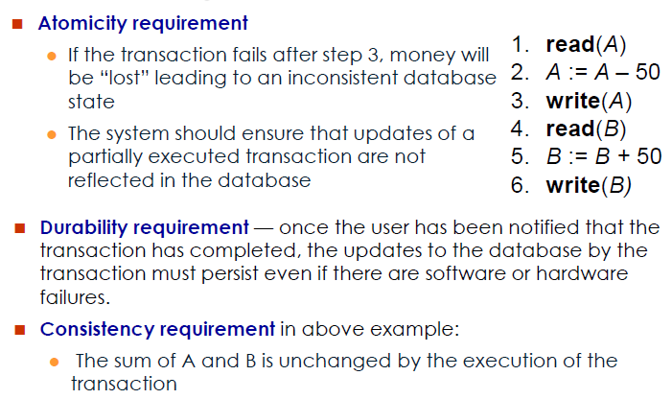
ACID Properties w.r.t a Transaction

Slide 31
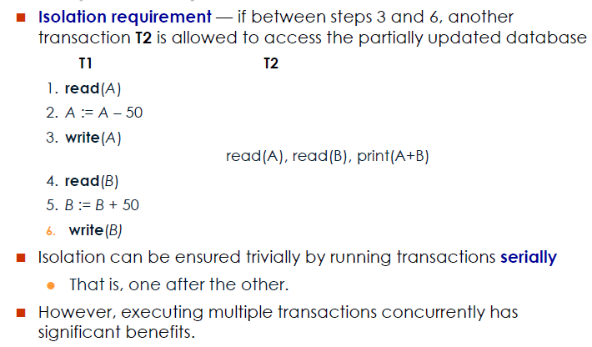
ACID Properties w.r.t a Transaction

Slide 32
Schedule
Transaction schedule or history
When transactions are executing concurrently in an interleaved fashion, the order of execution of operations from the various transactions forms what is known as a transaction schedule (or history)
A schedule (or history) S of n transactions T₁, T₂, ..., T_{n}
It is an ordering of the operations of the transactions subject to the constraint that, for each transaction T_{i} that participates in S, the operations of T_{i} in S must appear in the same order in which they occur in T_{i}.
Note, however, that operations from other transactions T_{j} can be interleaved with the operations of T_{i} in S

Slide 33
Schedule
Schedule - a sequences of instructions that specify the chronological order in which instructions of concurrent transactions are executed
A schedule for a set of transactions must consist of all instructions of those transactions
Must preserve the order in which the instructions appear in each individual transaction
A transaction that successfully completes its execution will have a commit instructions as the last statement
By default transaction assumed to execute commit instruction as its last step
A transaction that fails to successfully complete its execution will have an abort instruction as the last statement

Slide 34
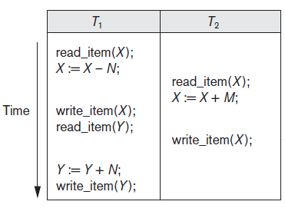
Schedule
To describe a schedule, use the symbols r, w, c, and a for the operations read_item, write_item, commit and abort, and appends as subscript the transaction id to each operation in the schedule
For example
S_{a} : r1 (X); r2 (X); w1 (X); r1 (Y); w2 (X); w1 (Y);

Slide 35
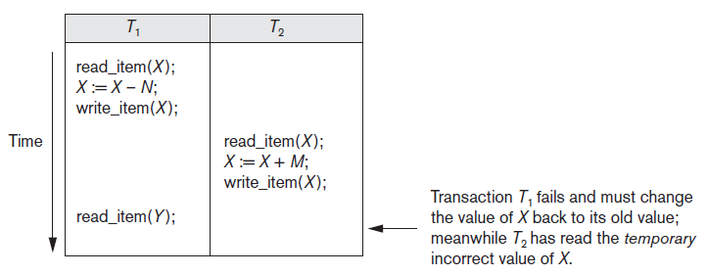
Schedule
S_{b}: r1(X); w1(X); r2(X); w2(X); r1(Y); a1;

Slide 36
Characterizing Schedules based on Recoverability
Schedules classified on recoverability
(1) Recoverable schedule
A schedule S is recoverable if no transaction T in S commits until all transactions T’ that have written an item that T reads have committed
S₁: R₁(x), W₁(x), R₂(x), R₁(y), R₂(y), W₂(x), W₁(y), C₁, C₂;
S_{c} is not recoverable
S_{c}: r₁(X); w₁(X); r₂(X); r₁(Y); w₂(X); c₂; a₁;

Slide 37
Characterizing Schedules based on Recoverability
(2) Cascadeless schedule
  One where every transaction reads only the items that are written by committed transactions
Schedules requiring cascaded rollback
  A schedule in which uncommitted transactions that read an item from a failed transaction must be rolled back

Slide 38
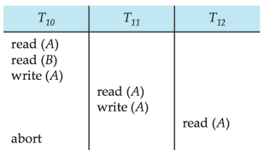
Characterizing Schedules based on Recoverability
Cascading rollback – a single transaction failure leads to a series of transaction rollbacks. Consider the following schedule where none of the transactions has yet committed (so the schedule is recoverable)
If T₁₀ fails, T₁₁ and T₁₂ must also be rolled back
Can lead to the undoing of a significant amount of work

Slide 39
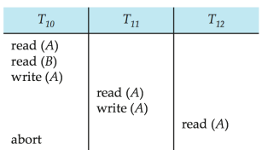
Characterizing Schedules based on Recoverability
Cascadeless schedules - for each pair of transactions T_{i} and T_{j} such that T_{j} reads a data item previously written by T_{i} , the commit operation of T_{i} appears before the read operation of T_{j}
Every cascadeless schedule is also recoverable
Example of a schedule that is NOT cascadeless
A schedule is said to be
cascadeless, or to avoid
cascading rollback, if
every transaction in the schedule
reads only items that were
written by committed transactions

Slide 40
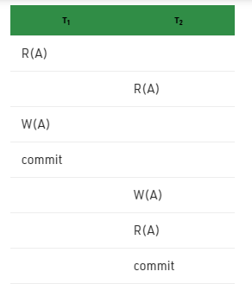
Characterizing Schedules based on Recoverability
(3) Strict Schedules
A schedule in which a transaction can neither read or write an item X until the last transaction that wrote X has committed (or aborted)
Strict schedules simplify the recovery process
This is a strict schedule since T₂
reads and writes A which is written
by T₁ only after the commit of T₁

Slide 41
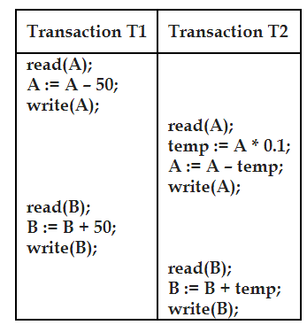
Serializable schedule
If we permit a set of transactions to execute simultaneously as a concurrent schedule, if the schedule is able to produce the same result as some serial execution of this schedule, then we call the schedule as serializable schedule.

Slide 42
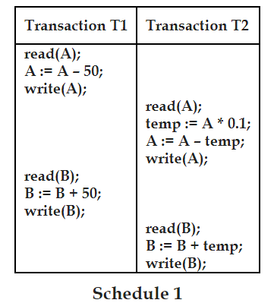
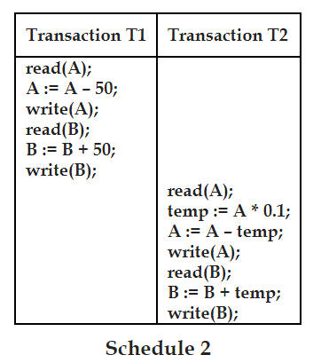
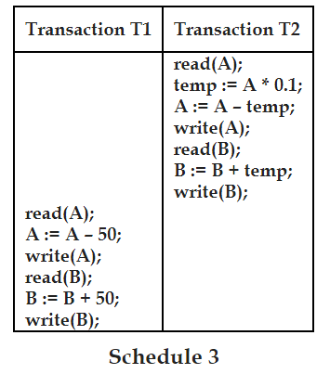
Serializable schedule
Let us suppose A = 1000 and B = 1000 at the start of the schedule 1. The values of A and B at the end of the execution of schedule 1 are 855 and 1145. Schedules 2 and 3 are serial schedules. All instructions of T1 finish before T2 in schedule 2. All instructions of T2 finish before T1 in schedule 3.

Slide 43
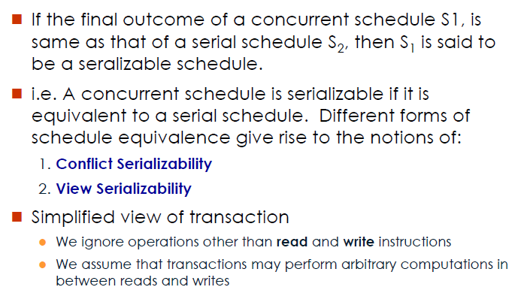
Serializability

Slide 44
Characterizing Schedules Based on Serializability
Serial schedule
  A schedule S is serial if, for every transaction T participating in the schedule, all the operations of T are executed consecutively in the schedule
    Otherwise, the schedule is called non-serial schedule
Serializable schedule
  A schedule S is serializable if it is equivalent to some serial schedule of the same n transactions

Slide 45
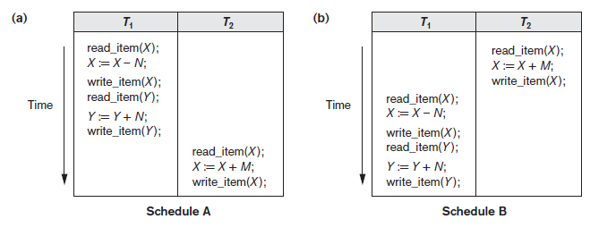
Characterizing Schedules Based on Serializability
Serial schedule A: T₁ followed by T₂
Serial schedule B: T₂ followed by T₁

Slide 46
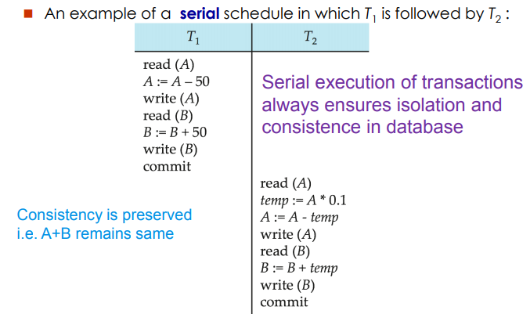
Serial Schedule

Slide 47
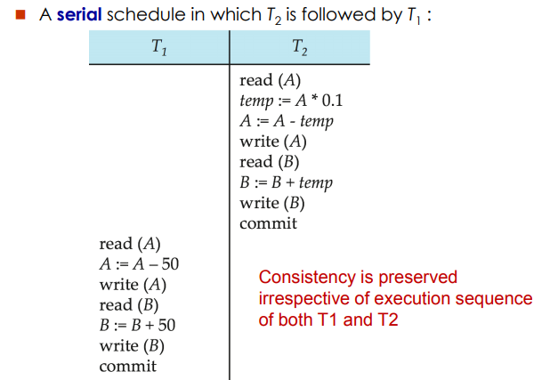
Serial Schedule

Slide 48
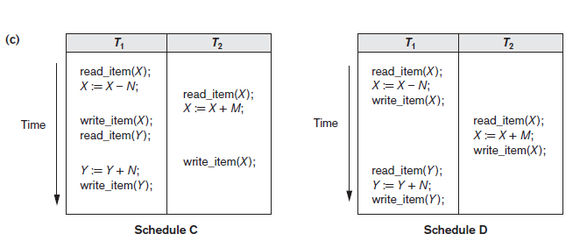
Non-Serial Schedule
Figure : Two non-serial schedules C and D with interleaving of operations.
Schedule C gives an erroneous result because of the lost update problem

Slide 49
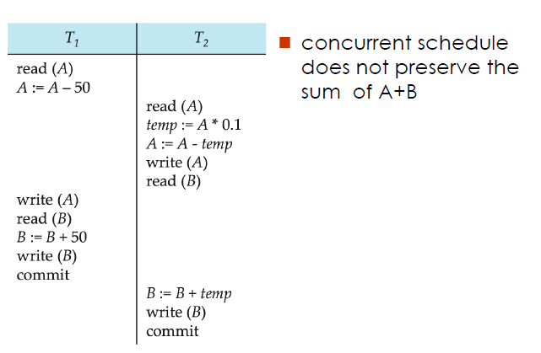
Non-Serial Schedule

Slide 50
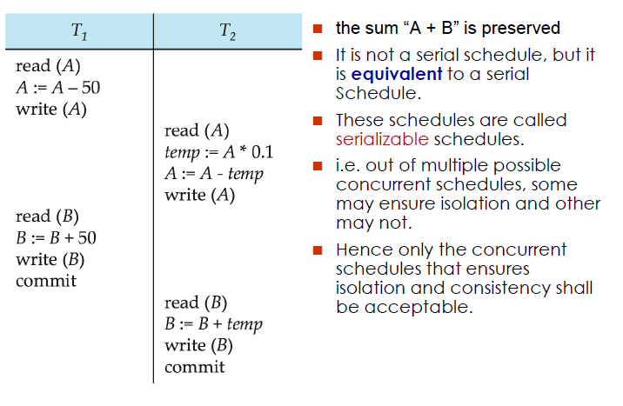
Non-Serial Schedule

Slide 51
Characterizing Schedules Based on Serializability
Result equivalent
  Two schedules are called result equivalent if they produce the same final state of the database
Conflict equivalent
  Two schedules are said to be conflict equivalent if the order of any two conflicting operations is the same in both schedules
Conflict serializable
  A schedule S is said to be conflict serializable if it is conflict equivalent to some serial schedule S’
    S and S’ are conflict equivalent – means S is conflict serializable

Slide 52
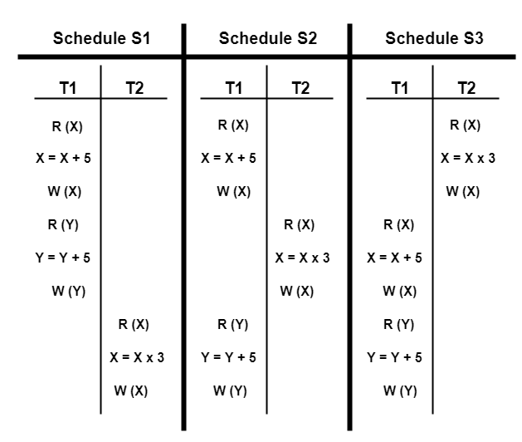
Characterizing Schedules Based on Serializability
Result equivalent
Let X = 2 and Y = 5
On substituting these values, the results produced by each schedule are-
Results by Schedule S1
X = 21 and Y = 10
Results by Schedule S2
X = 21 and Y = 10
Results by Schedule S3
X = 11 and Y = 10
The results produced by schedules S1 and S2 are same.
We conclude that S1 and S2 are result equivalent schedules

Slide 53
Characterizing Schedules Based on Serializability
Two operations in the schedule are said to conflict if they satisfy all three of the following conditions:
  1. The belong to different transactions
  2. They access the same item X
  3. Either both are write_item (X) operations or one is a
  write_item(X) and the other a read_item(X)
For example
S_{a} : r1 (X); r2 (X); w1 (X); r1 (Y); w2 (X); w1 (Y);
In S_{a} the operations r1 (X) and w2 (X) conflict
S_{b} : r1 (X); r2 (X); w1 (X); r1 (Y); w2 (X); w1 (Y);
In S_{b} r1 (X) and w1 (X) do not conflict

Slide 54
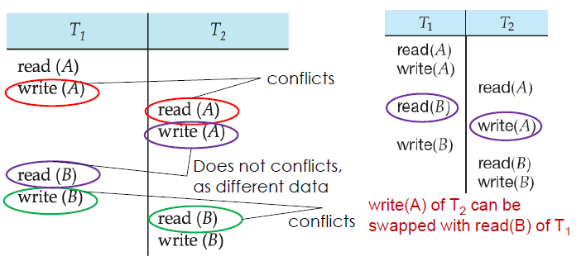
Characterizing Schedules Based on Serializability
If a schedule S1 can be transformed into a schedule S2 by a series of swaps of non-conflicting instructions, we say that S1 and S2 are conflict equivalent
ie., Two schedules are said to be conflict equivalent iff
  They contain the same set of the transactions
  If each pair of conflict operations are ordered in the same way

Slide 55
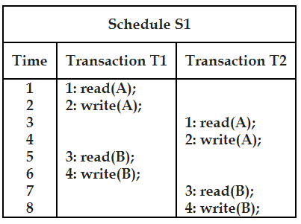
Characterizing Schedules Based on Serializability
Conflict serializable
  A schedule S is said to be conflict serializable if it is conflict equivalent to some serial schedule S’
Find whether the following schedule is conflict serializable or not?

Slide 56
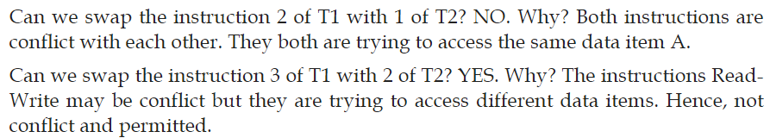
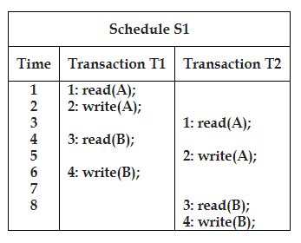
Characterizing Schedules Based on Serializability
We can do series of swaps as follows to arrive at a serial schedule S2;
After Swapping ins.3 of T1 with 2 of T2

Slide 57
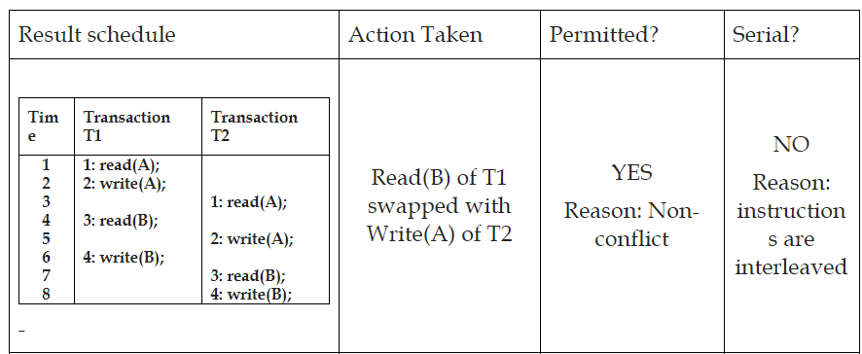
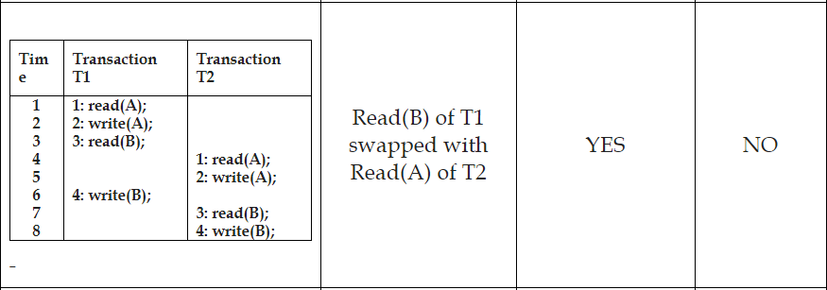
Characterizing Schedules Based on Serializability

Slide 58
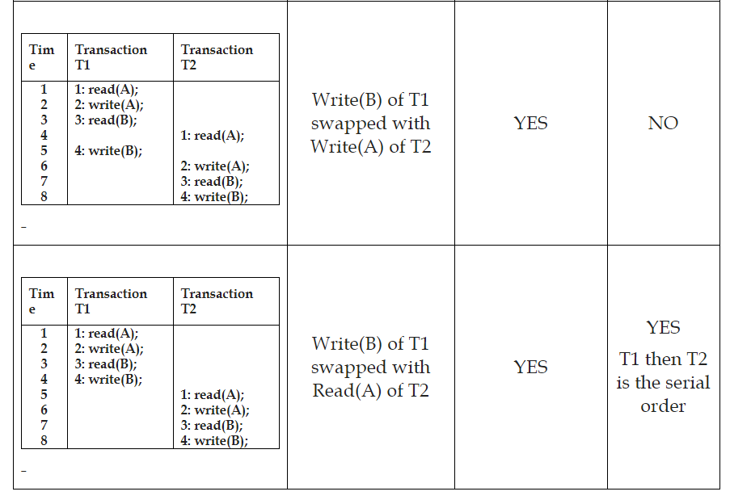
Characterizing Schedules Based on Serializability
Hence, Schedule S1 is conflict serializable to the serial schedule T1-T2

Slide 59
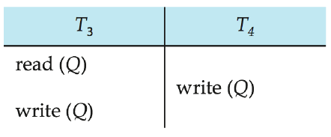
Characterizing Schedules Based on Serializability
Example of a schedule that is not conflict serializable
It is not possible to swap instructions in the above schedule to obtain a serial schedule

Slide 60
Characterizing Schedules Based on Serializability
Serializability is hard to check
  Interleaving of operations occurs in an operating system through some scheduler
  Difficult to determine beforehand how the operations in a schedule will be interleaved
Practical approach:
Come up with methods (protocols) to ensure serializability
It’s not possible to determine when a schedule begins and when it ends
  Hence, we reduce the problem of checking the whole schedule to checking only a committed project of the schedule (i.e. operations from only the committed transactions.)
Current approach used in most DBMSs:
  Use of locks with two phase locking

Slide 61
Characterizing Schedules Based on Serializability
Testing for Conflict Serializability of a Schedule
  The algorithm for testing conflict serializability of schedules here to gain a better understanding of these concurrency control protocols
The algorithm looks at only the read_item and write_item operations in a schedule to construct a precedence graph (or serialization graph), which is a directed graph G = (N, E) that consists of a set of nodes N = {T₁, T₂, ..., T_{n} } and a set of directed edges E = {e₁, e₂, ..., e_{m} }
There is one node in the graph for each transaction T_{i} in the schedule
Each edge e_{i} in the graph is of the form (Tj→Tk ), 1 ≤ j ≤ n, 1 ≤ k ≤ n, where T_{j} is the starting node of e_{i} and T_{k} is the ending node of e_{i}. Such an edge from node Tj to node T_{k} is created by the algorithm if one of the operations in T_{j} appears in the schedule before some conflicting operation in T_{k}

Slide 62
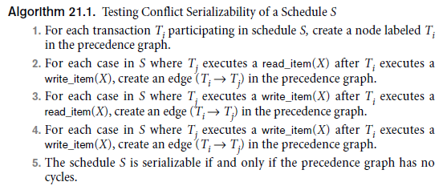
Characterizing Schedules Based on Serializability

Slide 63
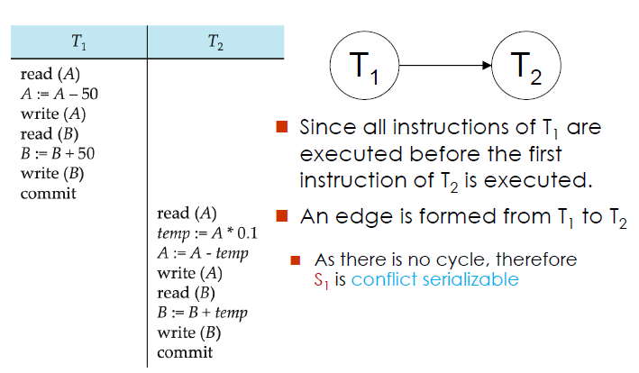
Characterizing Schedules Based on Serializability

Slide 64
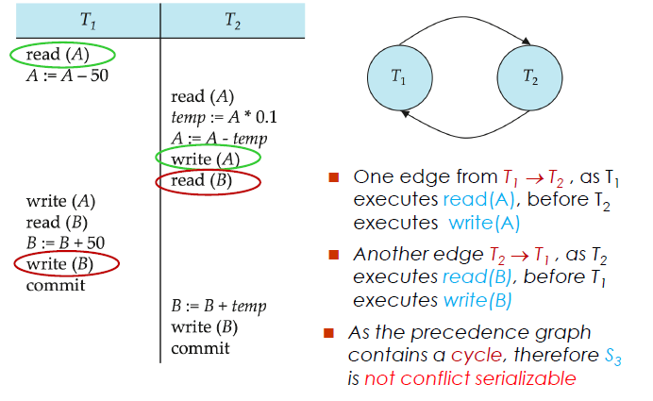
Characterizing Schedules Based on Serializability

Slide 65
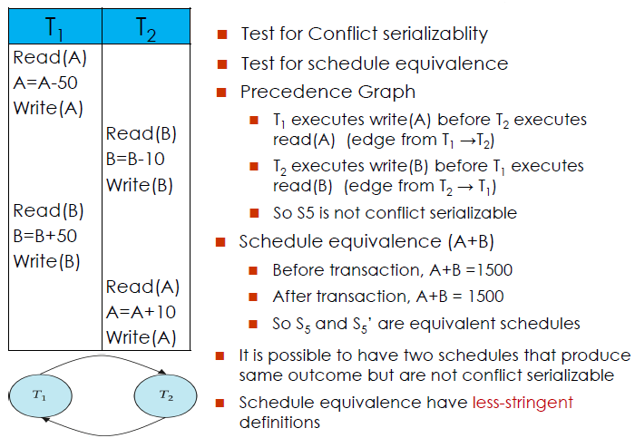
Characterizing Schedules Based on Serializability

Slide 66
Characterizing Schedules Based on Serializability
View Serializability
A schedule is view serializable if it is view equivalent to a serial schedule
A schedule is said to be view equivalent if all of the following conditions met by the schedule;
Consider two transactions T1 and T2 and two schedules S1 and S2. S1 and S2 are said to be view equivalent if the following conditions satisfied;
  If T1 reads a data item Q initially in S1 then T1 must read Q initially in S2
  In S1, if T1 reads a data item Q which is resulted in the write operation of T2, then in S2 also T1 must read Q which is written by T2
  If T1 writes the final value of a data item Q in S1, then T1 must write the final value of Q in S2 also

Slide 67
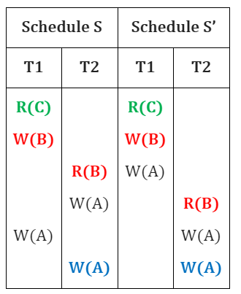
Characterizing Schedules Based on Serializability
Satisfaction of following conditions can be observed from the above table.
In schedule S and S’, T1 reads C first.
In schedule S and S’, T2 consumes B which is written by T1.
In schedule S and S’, T2 writes final A.
Schedule S is view equivalent to serial schedule S’
Hence, the schedule S is view serializable

Slide 68
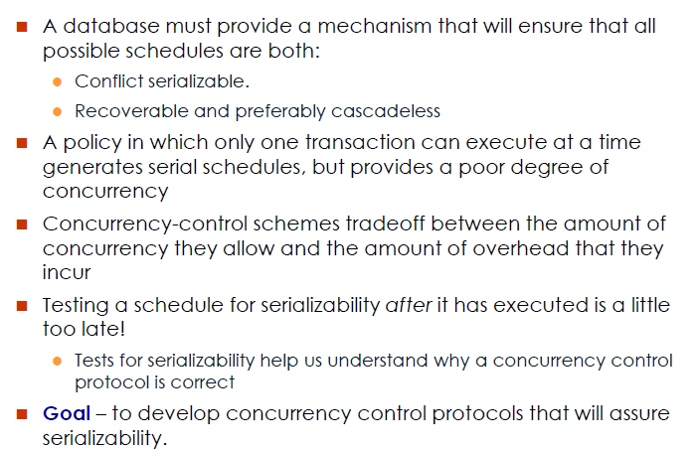
Concurrency Control

Slide 69
Concurrency Control
Is a mechanism to ensure isolation in a concurrent execution scenario
Achieved using the concept of mutual exclusion
  i.e. while one transaction is accessing a data item, no other transaction is allowed to modify that data item
Mutual exclusion is achieved using logical locks
Locks are granted/revoked by a central concurrency control manager
i.e. Transactions request it to grant a lock

Slide 70
Locks
  Locking is an operation which secures
    (a) permission to Read
    (b) permission to Write a data item for a transaction.
  Example:
    Lock (X). Data item X is locked in behalf of the requesting transaction.
  Unlocking is an operation which removes these permissions from the data item
  Example:
    Unlock (X): Data item X is made available to all other transactions
  Lock and Unlock are Atomic operations

Slide 71
Locks
Data items can be locked in two modes
Shared: Data item can only be read. Requested using lock-S instruction. It can be shared with other transactions
Exclusive: Data item can be both read as well as written. It is requested using lock-X instruction. It can’t be shared with other transactions
Shared locks may be granted to multiple transactions simultaneously
Exclusive locks can’t be granted to multiple transactions simultaneously

Slide 72
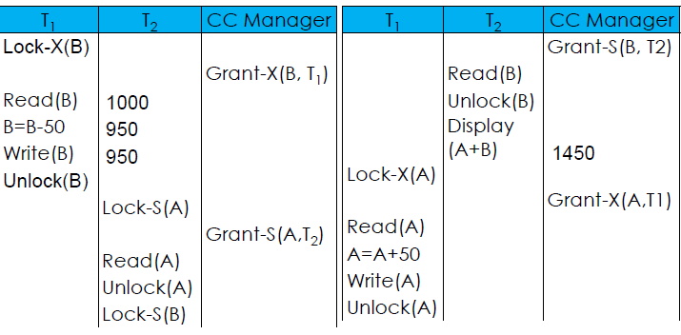
Locking Example
Produces inconsistent result
Transactions must hold the lock on a data item till it access that item.
It is not necessarily desirable for a transaction to unlock a data item immediately after its final access of that item, since the serializability may not be ensured.

Slide 73
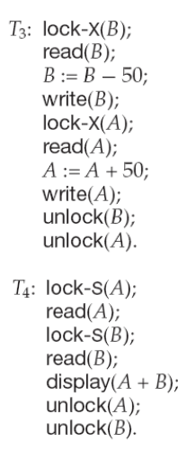
Delayed Unlocking
Produces consistent result
Unlocking is delayed to the end
of the transactions
This schedule produces consistent result
But this technique may lead to an undesirable
scenario called deadlock
When a transaction (T3) delays unlocking
on its locked data items (B) and requests to
acquire a lock on new data items (A) that is
already locked by another transaction (T4)
This is called a Hold-and-Wait situation

Slide 74
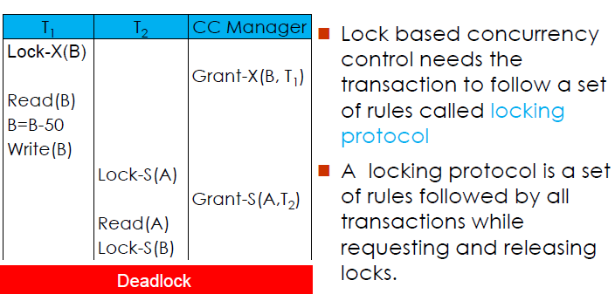
Deadlock due to Hold-and-Wait

Slide 75
The Two-Phase Locking Protocol (2PL)
It requires the transactions execute in two phases
Phase 1: Growing Phase
  Transaction may obtain locks
  Transaction may not release locks
Phase 2: Shrinking Phase
  Transaction may release locks
  Transaction may not obtain locks
i.e. The transaction acquires locks as needed. Once the transaction releases a lock, it can't issue any more lock requests

Slide 76
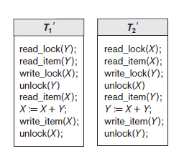
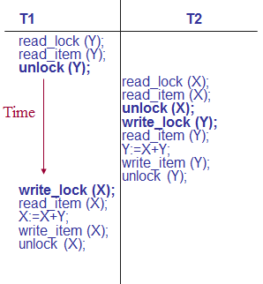
2PL
Transactions T1′ and T2 ′ follow the two-phase locking protocol.
Transactions that do not obey 2PL

Slide 77
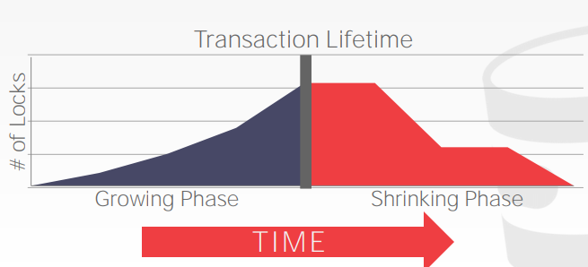
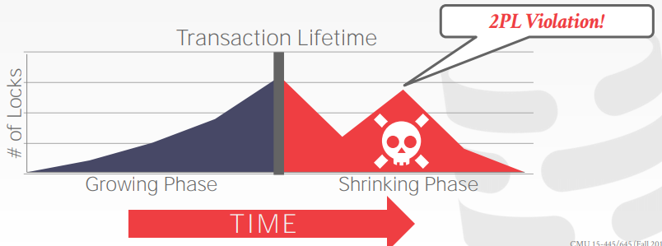
2PL
The transaction is not allowed to acquire/upgrade locks after the growing phase finishes

Slide 78
Properties of 2PL
2PL ensures conflict serializability. The contributing transactions are isolated w.r.t. the lock point. (point at which growing phase ends and shrinking phase starts)
It does not ensure deadlock free execution. In the event of deadlock participating transactions are rolled back
It ensures recoverability but does not safeguard against cascading rollback.
Strict two phase locking is an enhanced 2PL that ensures cascadeless recovery. Strict 2PL requires that not only the locking and unlocking be in two phases, all the exclusive mode locks must be hold by the transaction till the transaction commits.
In Rigorous 2PL both the locks are held till the transaction commits

Slide 79
2PL
Two-Phase Locking Techniques: The algorithm
Two-phase policy generates two locking algorithms
  (a) Basic
  (b) Conservative
Conservative
  Prevents deadlock by locking all desired data items before transaction begins execution.
Basic
  Transaction locks data items incrementally. This may cause deadlock which is dealt with.
Strict
  A more stricter version of Basic algorithm where unlocking is performed after a transaction terminates (commits or aborts and rolled-back). This is the most commonly used two-phase locking algorithm.

Slide 80
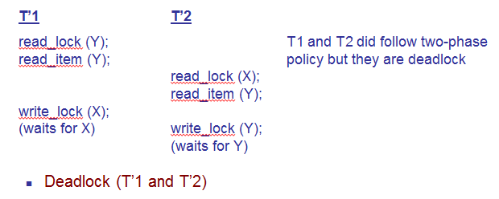
Dealing with Deadlock and Starvation

Slide 81
Dealing with Deadlock and Starvation
Deadlock prevention
  A transaction locks all data items it refers to before it begins execution
  This way of locking prevents deadlock since a transaction never waits for a data item
  The conservative two-phase locking uses this approach

Slide 82
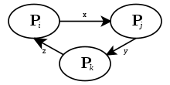
Dealing with Deadlock and Starvation
Deadlock detection and resolution
  In this approach, deadlocks are allowed to happen. The scheduler maintains a wait-for-graph for detecting cycle. If a cycle exists, then one transaction involved in the cycle is selected (victim) and rolled-back
  A wait-for-graph is created using the lock table. As soon as a transaction is blocked, it is added to the graph. When a chain like: Ti waits for Tj waits for Tk waits for Ti or Tj occurs, then this creates a cycle

Slide 83
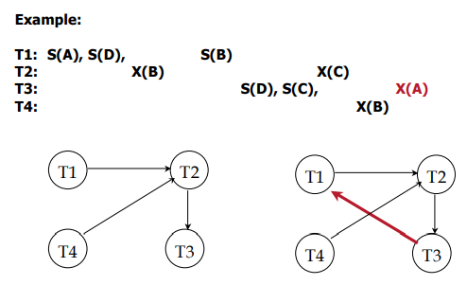
Dealing with Deadlock and Starvation
Wait-for graph
  Nodes are transactions
  There is an edge from T_{i} to T_{j} if T_{i} is waiting for T_{j} to release a lock
Periodically check for cycles in the waits-for graph

Slide 84
Dealing with Deadlock and Starvation
Deadlock avoidance
  There are many variations of two-phase locking algorithm
  Some avoid deadlock by not letting the cycle to complete
  That is as soon as the algorithm discovers that blocking a transaction is likely to create a cycle, it rolls back the transaction
  Wound-Wait and Wait-Die algorithms use timestamps to avoid deadlocks by rolling-back victim

Slide 85
Dealing with Deadlock and Starvation
Starvation
  Starvation occurs when a particular transaction consistently waits or restarted and never gets a chance to proceed further.
  In a deadlock resolution it is possible that the same transaction may consistently be selected as victim and rolled-back.
  This limitation is inherent in all priority based scheduling mechanisms.
  In Wound-Wait scheme a younger transaction may always be wounded (aborted) by a long running older transaction which may create starvation

